Slide 1
Business Disability Forum
Working with governments and business
Davina Critchley and Brendan Roach
23 October 2020

Slide 2
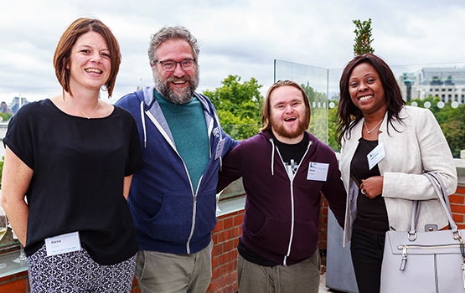
We are Business Disability Forum
We believe the 26 million people in the UK and over 1 billion people worldwide with disabilities and long-term conditions enhance the social and economic health of our societies.
We exist to remove barriers in business structures and Government that prevent disabled people from thriving and contributing in this way.

Slide 3


















Some of our Partners
Notes:
We represent around 300 organisations that employ 15% of the UK workforce and about 8 million people globally.

Slide 4
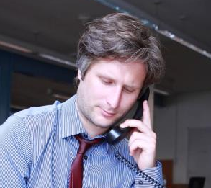
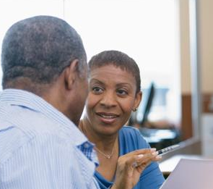
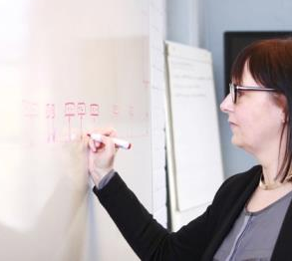
We think. We advise. We support.
Advice service
Taskforces and networks
Consultancy and
L&D
Notes:
Our leading business inclusion Advice Service provide a responsive space for any professional working on any aspect of disability inclusion to talk through ideas, trouble shoot, and get case support on the disability related challenges in their business.
Our events, sector networks, and subject task groups bring together professionals with shared interests to learn from one another, share insight, and collaborate on projects.

Slide 5
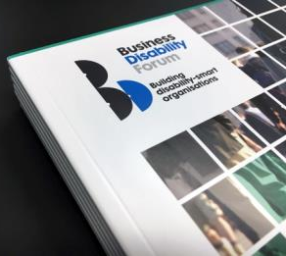


We share. We influence.
Resources and toolkits
Networking events
Research and insight
Notes:
Our events, sector networks, and subject task groups bring together professionals with shared interests to learn from one another, share insight, and collaborate on projects.
Our community of businesses, thought leaders, and disabled people develop research which influences policy development.
The role of our policy related research is to generate original insight from our unique position as the body who link disabled people, business, and Government.

Slide 6
A disability-smart organisation:
Understands how disability impacts on the whole organisation
Anticipates and removes barriers for groups
Makes adjustments for individuals
Does not make assumptions based on medical labels

Slide 7

Disability and the whole organisation
7

Slide 8
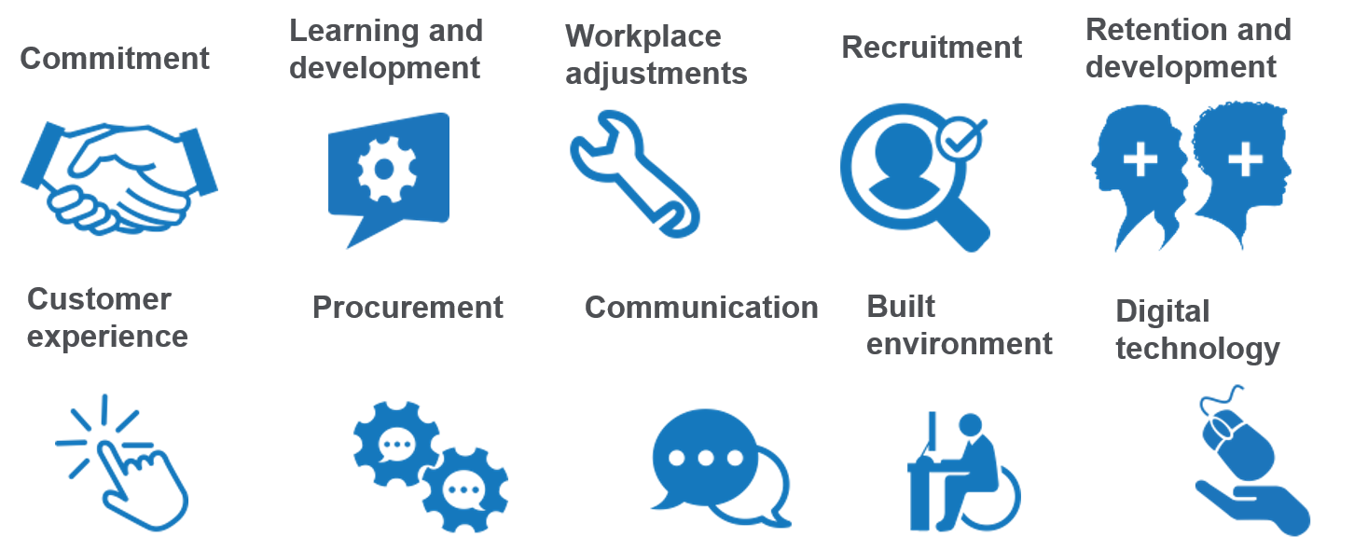
Disability Standard framework

Slide 9
The Global Taskforce
50%
of our members are global

Slide 10

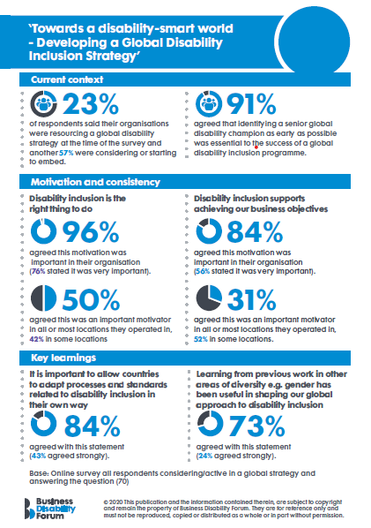
Towards a disability-smart world
Our Global Taskforce develops best practice approaches to disability inclusion across their global operations.

Slide 11
Contact us
Enquiries@businessdisabilityforum.org.uk
+44-(0)20-7403-3020
Business Disability Forum is committed to ensuring that all its products and services are as accessible as possible to everyone. If you wish to discuss anything with regard to accessibility, please contact us.
Company limited by guarantee with charitable objects.
Registered Charity No: 1018463.
Registered in England No: 2603700.

